Slide 1



COMPUTER GRAPHICS & MULTIMEDIA SYSTEMS- SCS1302
UNIT III - Part I

Slide 2
3D object representation methods Polygon Surfaces, Polygon Tables
Boundary Representations (B-reps) − It describes a 3D object as a set of surfaces that separates the object interior from the environment.
Space–partitioning representations − It is used to describe interior properties, by partitioning the spatial region containing an object into a set of small, non-overlapping, contiguous solids (usually cubes).
Each vertex stores x, y, and z coordinate information which is represented in the table as v₁: x₁, y₁, z₁.
The Edge table is used to store the edge information of polygon. In the following figure, edge E₁ lies between vertex v₁ and v₂ which is represented in the table as E₁: v₁, v₂.
Polygon surface table stores the number of surfaces present in the polygon. From the following figure, surface S₁ is covered by edges E₁, E₂ and E₃ which can be represented in the polygon surface table as S₁: E₁, E₂, and E₃.

Slide 3
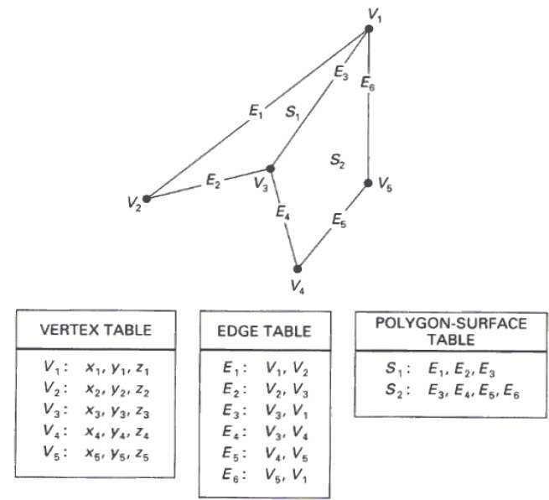
Polygon Tables

Slide 4
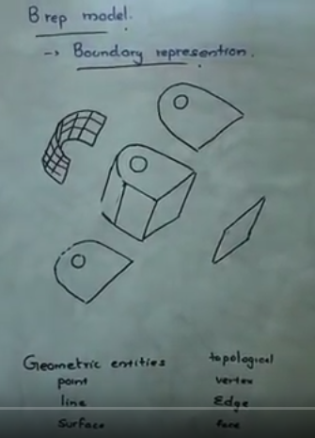
https://www.youtube.com/watch?v=sXbRT439vRI

Slide 5
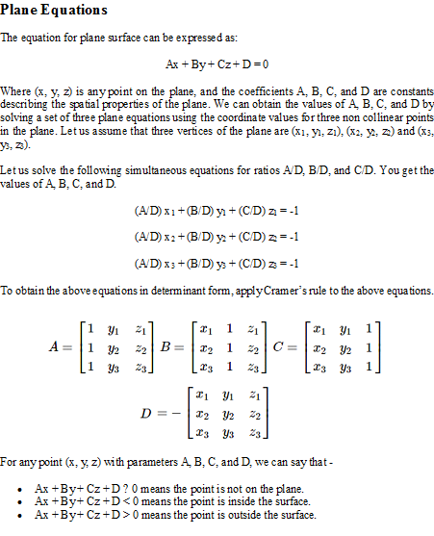
3D object representation methods

Slide 6
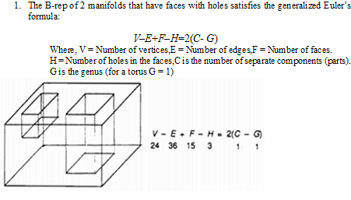
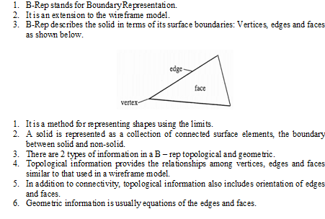
3D object representation methods
B-Rep:

Slide 7
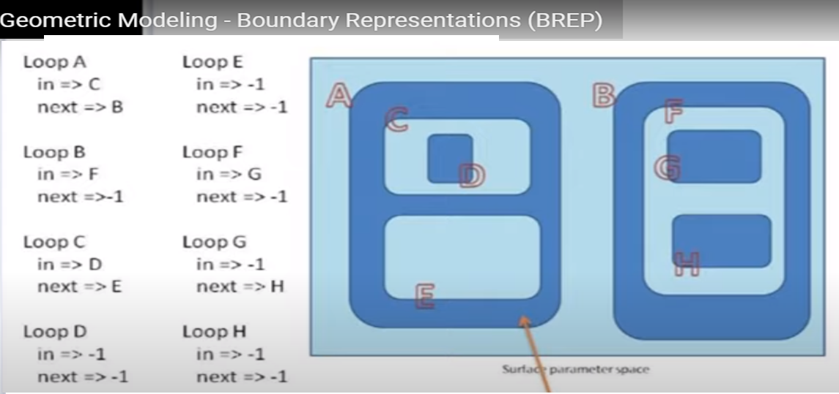

Slide 8
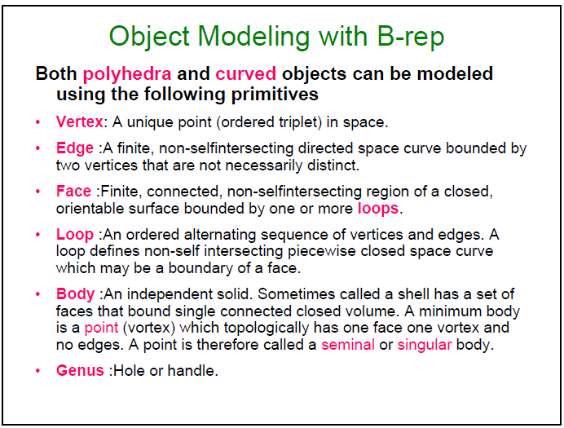

Slide 9
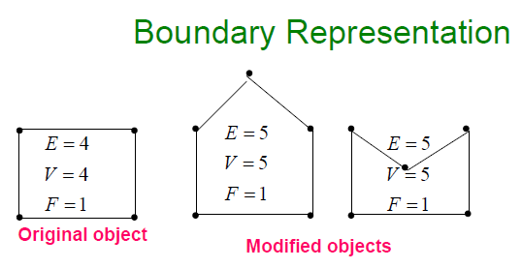

Slide 10
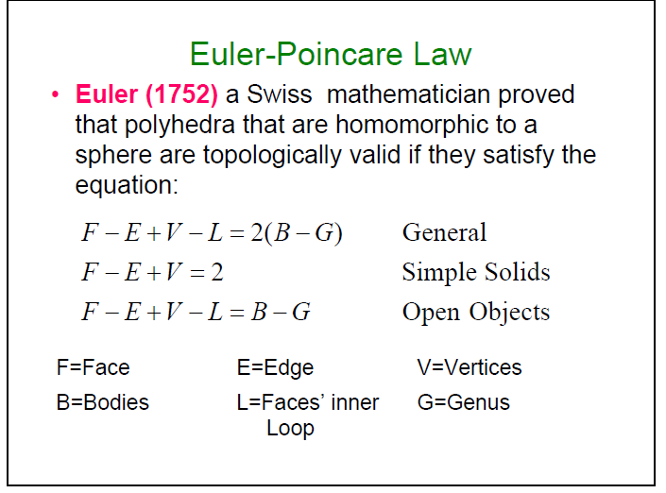

Slide 11
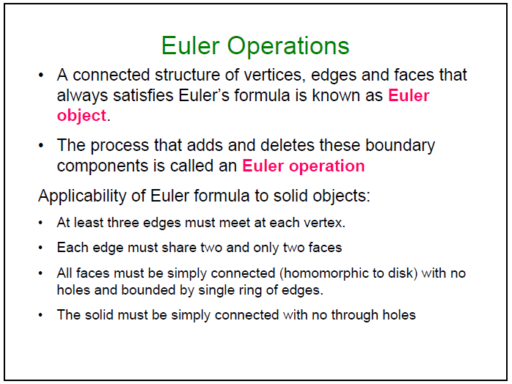

Slide 12
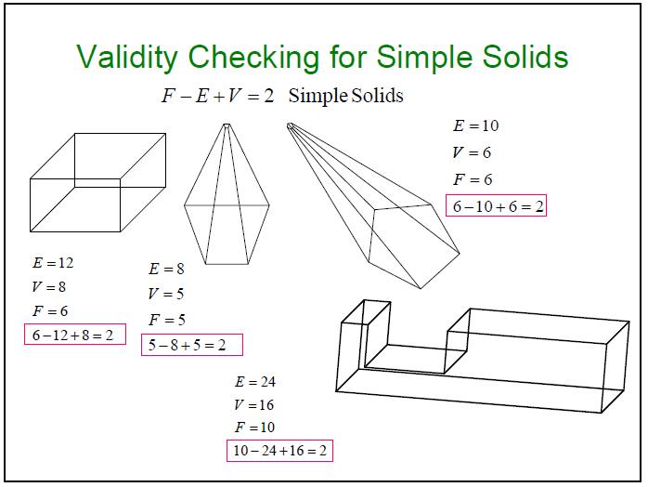

Slide 13
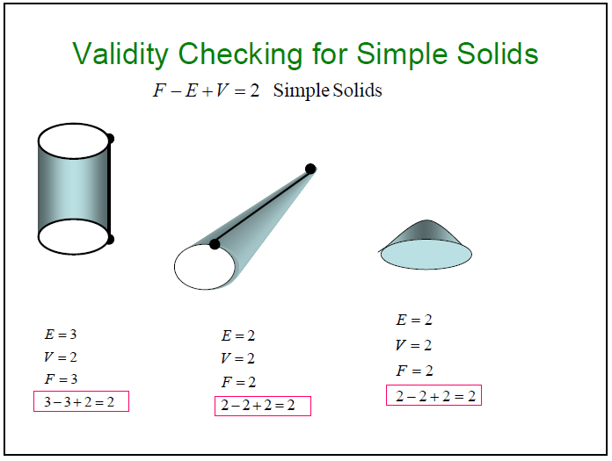

Slide 14
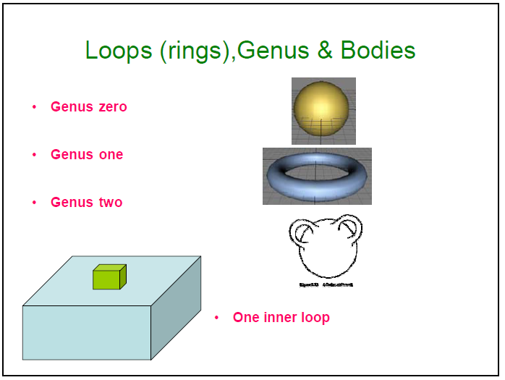

Slide 15
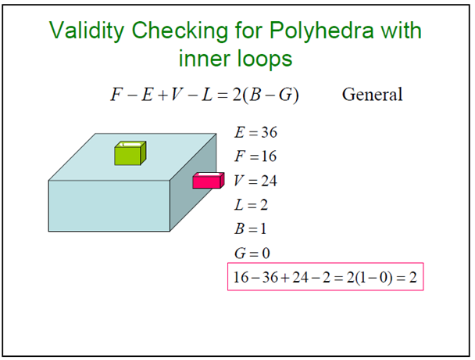

Slide 16
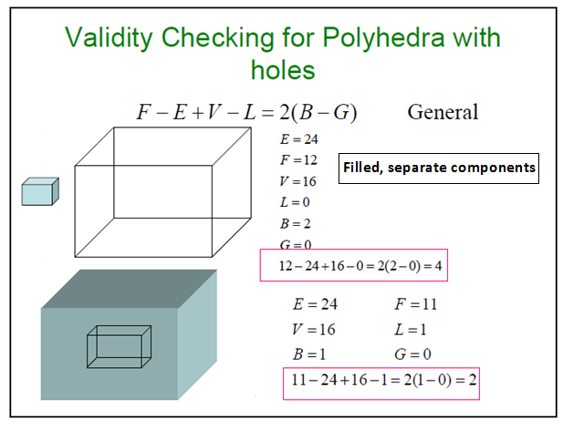

Slide 17
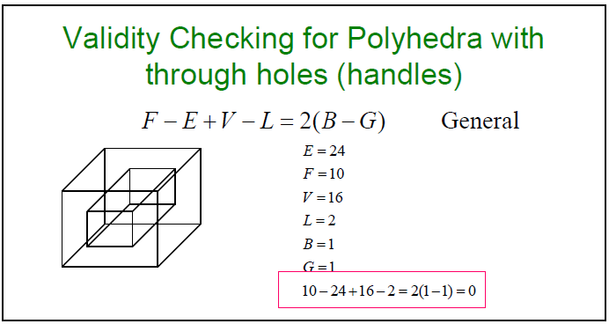

Slide 18
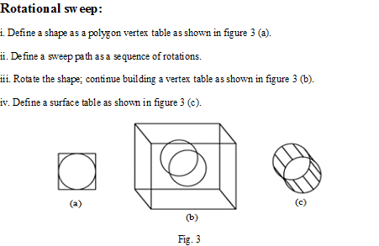
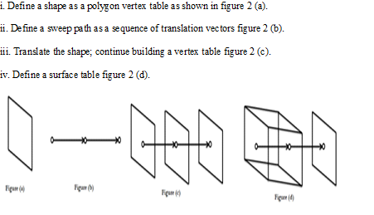
Sweep
Translational sweep:

Slide 19
SWEEP REPRESENTATIONS
https://www.youtube.com/watch?v=k_3lISNgkAo
https://www.youtube.com/watch?v=021P5-Vxl2o
http://www.dailyfreecode.com/code/creats-3d-solid-object-translational-654.aspx

Slide 20
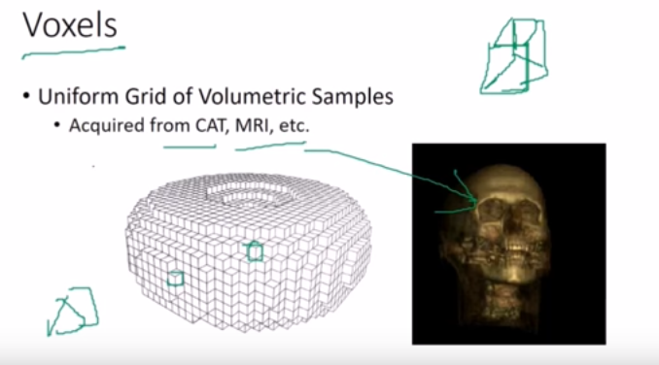

Slide 21
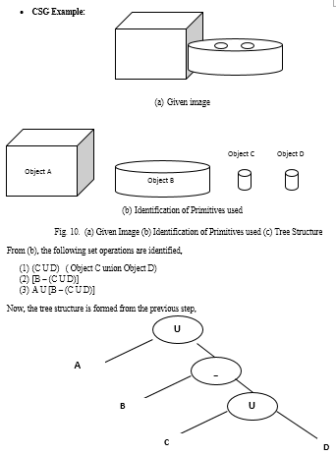
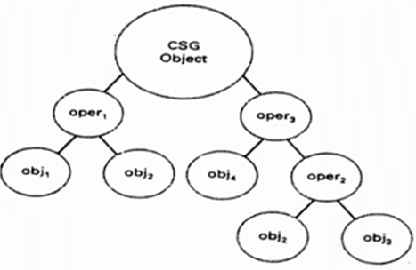
Sweep Representations: Sweep representations are used to construct 3D object from 2D shape that have some kind of symmetry.
CSG:
CSG stands for Constructive Solid Geometry.
It is based on set of 3D solid primitives and regularized set theoretic operations.
Traditional primitives are: Block, cones, sphere, cylinder and torus.
Operations: union, intersection, difference + translation and rotation.
A complex solid is represented using with a binary tree usually called as CSG tree.
CSG tree is shown below.

Slide 22
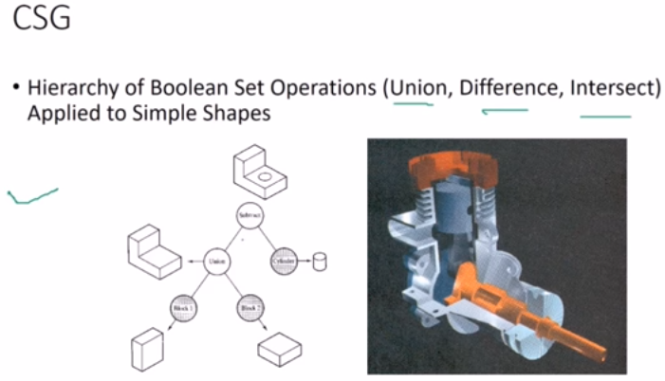

Slide 23
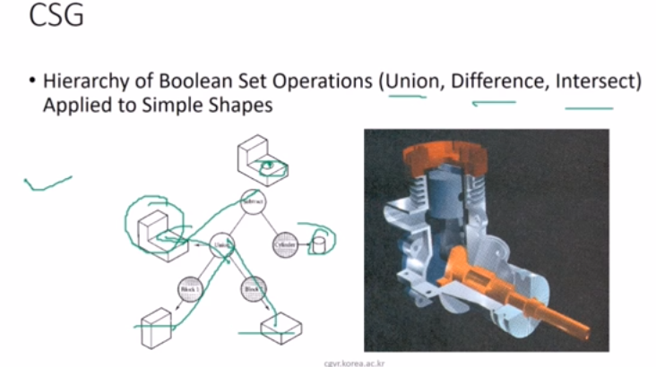

Slide 24
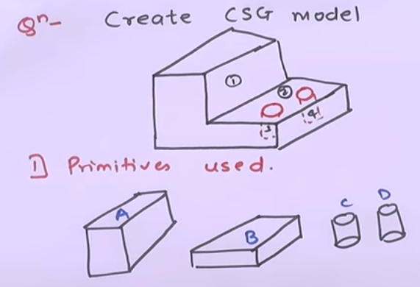
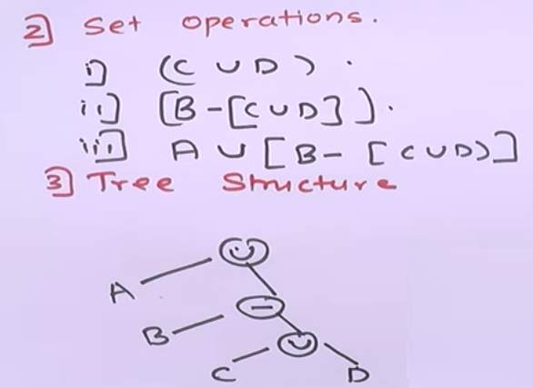

Slide 25
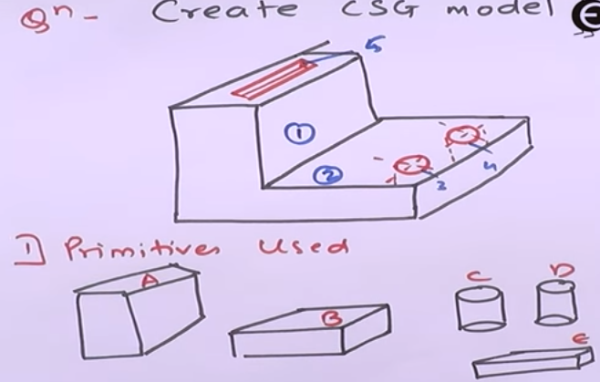
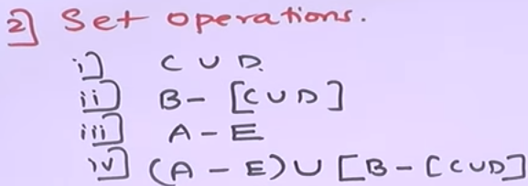

Slide 26
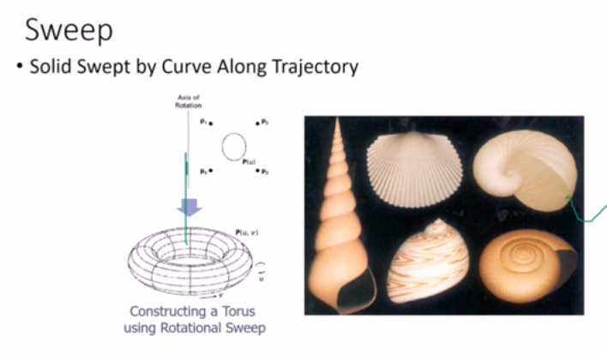

Slide 27
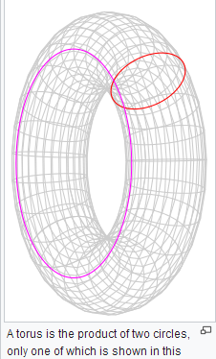

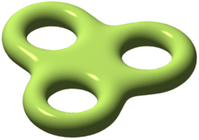
Genus, Torus

